Slide 1

AI Trip Planner Agent
Autonomous Web-Research & Itinerary Generation Powered by LangGraph
QAU | GROUP PROJECT ASSIGNMENT
Presented by:
Maayra Anjum 04162213026
Ishfa Waleed 04162213030
Rubab Zahra 04162213018

Slide 2

Project Overview
Redefining travel planning with agentic workflows

Slide 3





The Problem & Solution
The Challenge
Who Is It For & Why Did We Choose It?
Manual travel planning is fragmented and time-consuming. Travelers spend hours researching destinations, attractions, food options, and budgets across multiple sources.
For travelers who want quick trip planning. Chosen because it is a practical real-world problem that effectively demonstrates LangGraph's workflow and agent capabilities.
The AI Solution
An autonomous Trip Planner Agent that performs parallel research, merges information from multiple sources, and iteratively refines itineraries until they meet a predefined quality score.

Slide 4
Architecture & Logic

Slide 5
Hybrid Workflow
State Management (Typed State)
Parallel Execution
Maintains shared context across all nodes without
losing data.
Runs multiple research tasks simultaneously to improve
speed and efficiency.
Sequential Flow
Conditional Edges
Ensures ordered step-by-step execution for a structured pipeline.
Routes workflow based on itinerary score for intelligent
decision-making.
Iterative Loop
Tool Integration (Web Search)
Repeats refinement process until output meets quality
threshold.
Fetches real-time external data to improve accuracy
of results.

Slide 6
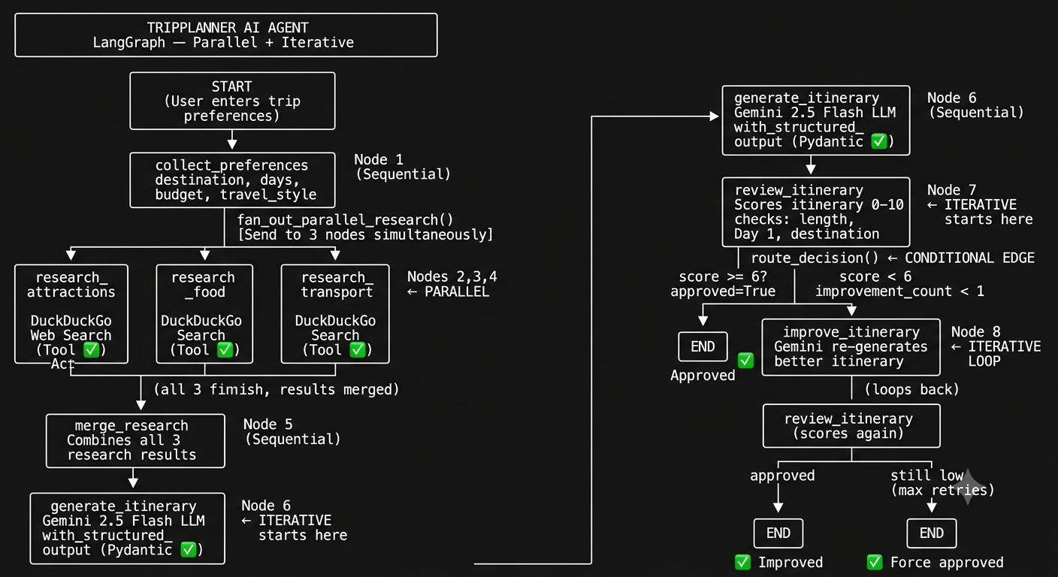

Slide 7
Live Demonstration
Exploring the Streamlit Interface

Slide 8
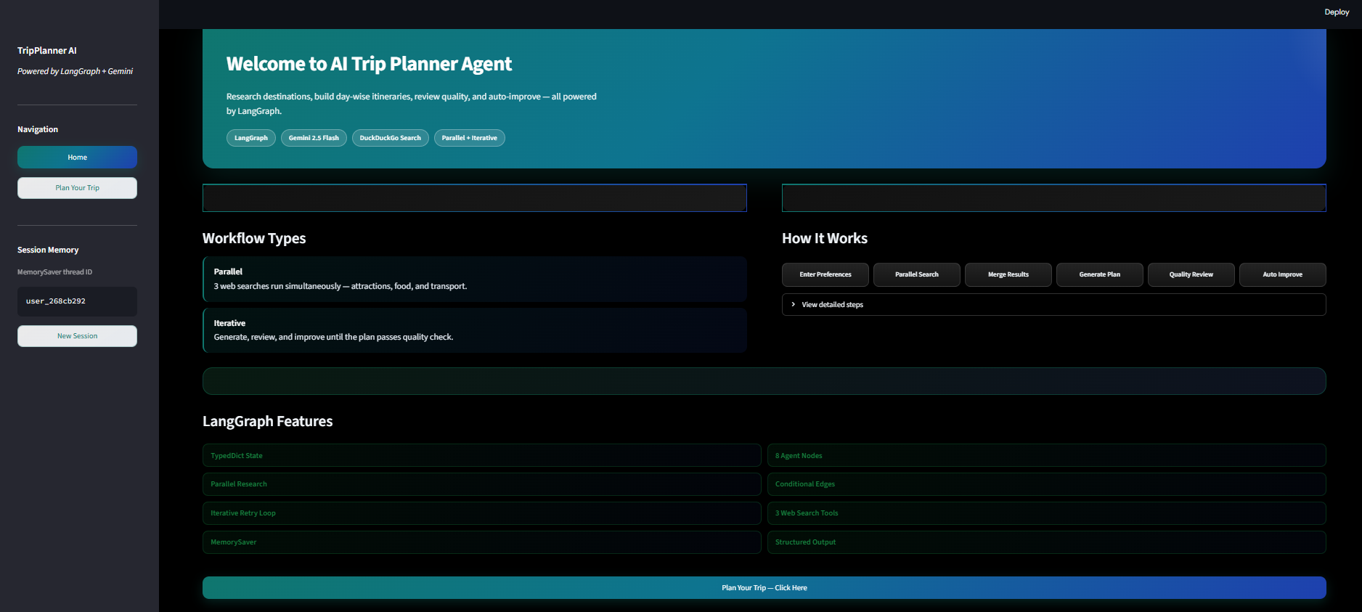
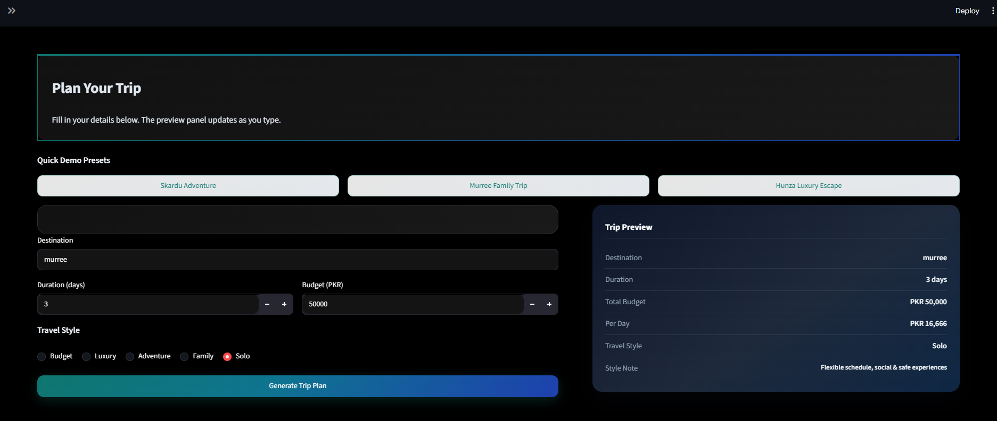
Streamlit UI & Interaction
Destination & Duration Input
Budget & Travel Style Selection
Parallel Research Execution
Real-time status logs for graph nodes
Final Itinerary with review scores

Slide 9
Questions?
Thank you for your time!
https://github.com/maayra-anjum/trip-planner
https://github.com/Ishfa-Waleed/trip-planner
https://github.com/zs299386-hue/trip-planner

